Slide 1


Connectivity
Pavel Genevski, Research Expert @ SAP Labs Bulgaria March, 2017

Slide 2
Agenda
Intro to communications
Information theory
Channel characteristics & media types
Encoding and error control
Internet refresher …
TCP/IP & HTTP
CoAP & MQTT
IoT specific protocols
Wireless: Wifi/HaLow, BT 4.0, LoRa, LTE, Zigbee, Z-wave, 6LowPAN
Wired: UART/RS485, SPI, I2C, OneWire, Ethernet, Modbus?, 4-20 mA

Slide 3
Intro to communications
Notes:
https://gearjunkie.com/legacy/images/21010.jpg
https://tctechcrunch2011.files.wordpress.com/2014/11/victoria-secret-heart-rate-bra.jpg?w=738
https://cochlearimplanthelp.files.wordpress.com/2015/04/mi-band.jpg

Slide 4

What is information?
Subject
knows
Object
Data
Datum = something given, a thing
Knowledge
Subject + data = experience
Learning = increasing knowledge
Reduces uncertainty
Improves outcome
Information
Conveys knowledge increments
Measured in bits
Entropy (data vs information)
Reducing uncertainty
P (A | E ) > P(A)
Improving outcome
O’_{T} | E > O_{T}
Quantity of information
I(m) = log₂(M) [bit]
Entropy
H = - sum( P_{i} log₂(P_{i}) ) [bit]
Shannon, Nyquist, Hartley, Mitchell
Notes:
https://en.wikipedia.org/wiki/Information
Tom Mitchell
Claude Shannon

Slide 5
What is communication?
Communication
Conveying information (knowledge)
Encoding & decoding
Knowledge <-> Data
Transmission & reception
Data <-> Signal (energy wave)
Channel
Carries and modifies the signal / data
Information may be affected
Source
Info
Encoder
Data
Transmitter
Signal
Channel
Noise
Receiver
Decoder
Destination

Slide 6
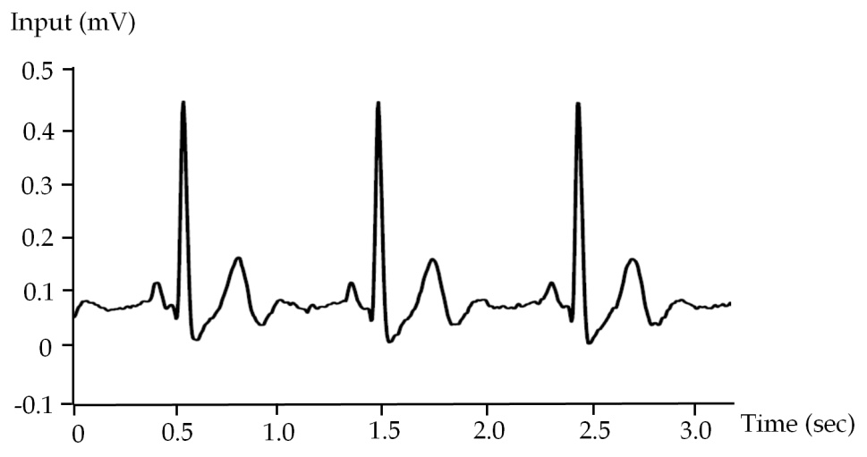
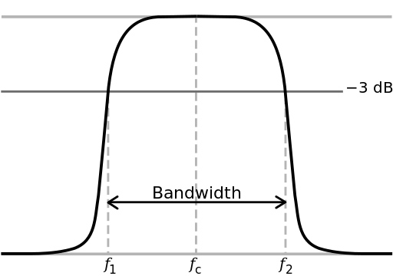
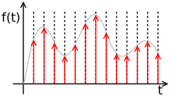
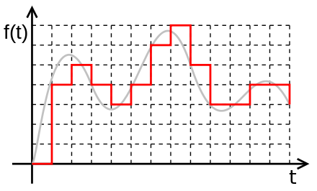
Signal & channel characteristics
Signal
An energy wave
Spectrum (Fourier sum of sine waves)
Channel
Bandwidth, power, noise, attenuation
Latency
Capacity: C = B log₂(1+P_{S}/P_{N}) [bit/s]
Digital signal
Time discretization (Nyquist): F_{S} > 2B
Amplitude quantization:
SQNR = 20log₁₀(2^{Q}) = 6.02 Q [dB]
* Signal to quantization noise ratio: Q bits
Notes:
https://upload.wikimedia.org/wikipedia/commons/thumb/f/f6/Bandwidth.svg/512px-Bandwidth.svg.png
https://en.wikipedia.org/wiki/Colors_of_noise
https://upload.wikimedia.org/wikipedia/commons/thumb/9/9a/Digital.signal.svg/440px-Digital.signal.svg.png
https://upload.wikimedia.org/wikipedia/commons/thumb/8/88/Sampled.signal.svg/220px-Sampled.signal.svg.png
http://www.wikiwand.com/en/Signal_(electrical_engineering)
https://en.wikipedia.org/wiki/Nyquist%E2%80%93Shannon_sampling_theorem
https://en.wikipedia.org/wiki/Signal-to-quantization-noise_ratio

Slide 7
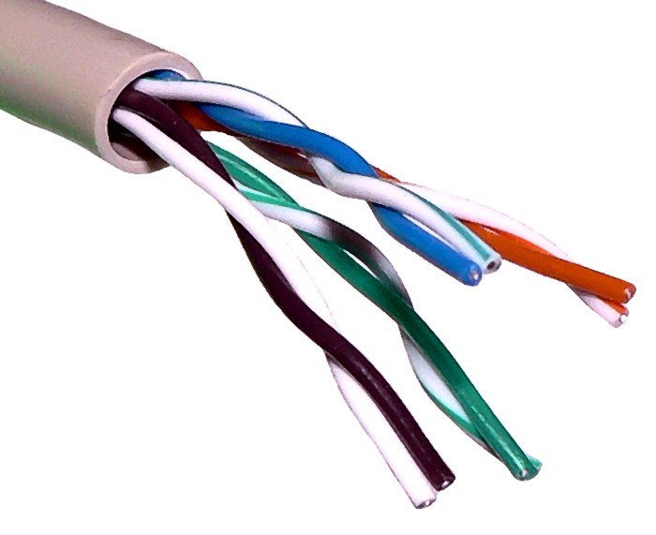
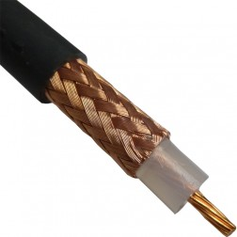
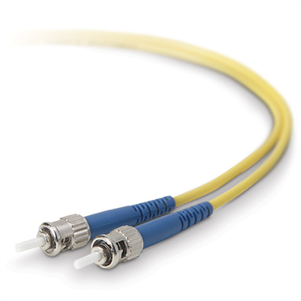
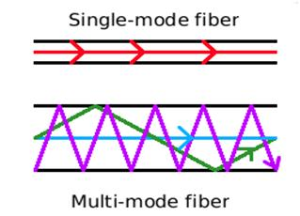
Common media types
Electrical wires
Twisted pair: 10 GB/s, 100 m, 0.5 EUR/m
Coaxial: 10 MB/s, 450m, 0.5 EUR/m
Optical fibers
Single mode: 100TB/s, ~150 km, 0.06 EUR/m
Multi-mode: 1GB/km, ~2 km, 0.3 EUR/m
Radio (ISM bands)
2.4 / 5GHz: 300MB/s, 50 m
433 / 868 MHz: 64KB/s, 20 km
Notes:
https://en.wikipedia.org/wiki/Twisted_pair
http://www.ni.com/product-documentation/13724/en/
https://en.wikipedia.org/wiki/Fiber-optic_communication
http://www.belkin.com/images/product/f2f80200/372.jpg
http://www.fiberopticcableproducts.com/fiber_optic_products_files/image11821.jpg
https://www.cablewholesale.com/products/fiber-optic/singlemode-duplex-9-125/product-10f3-012nh.php
http://blog.rfvenue.com/multi-mode-vs-single-mode/
http://www.ti.com/lit/an/swra048/swra048.pdf
https://arxiv.org/pdf/1605.08309.pdf

Slide 8
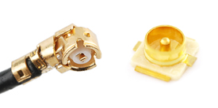
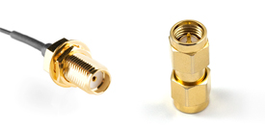
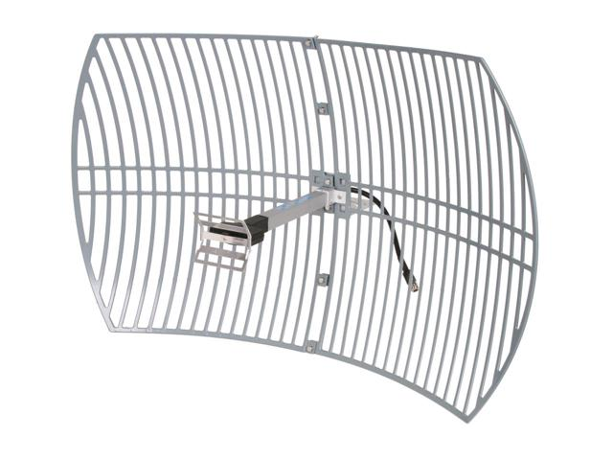
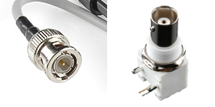
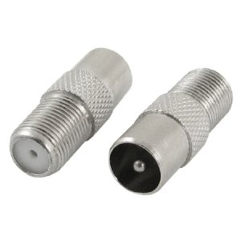
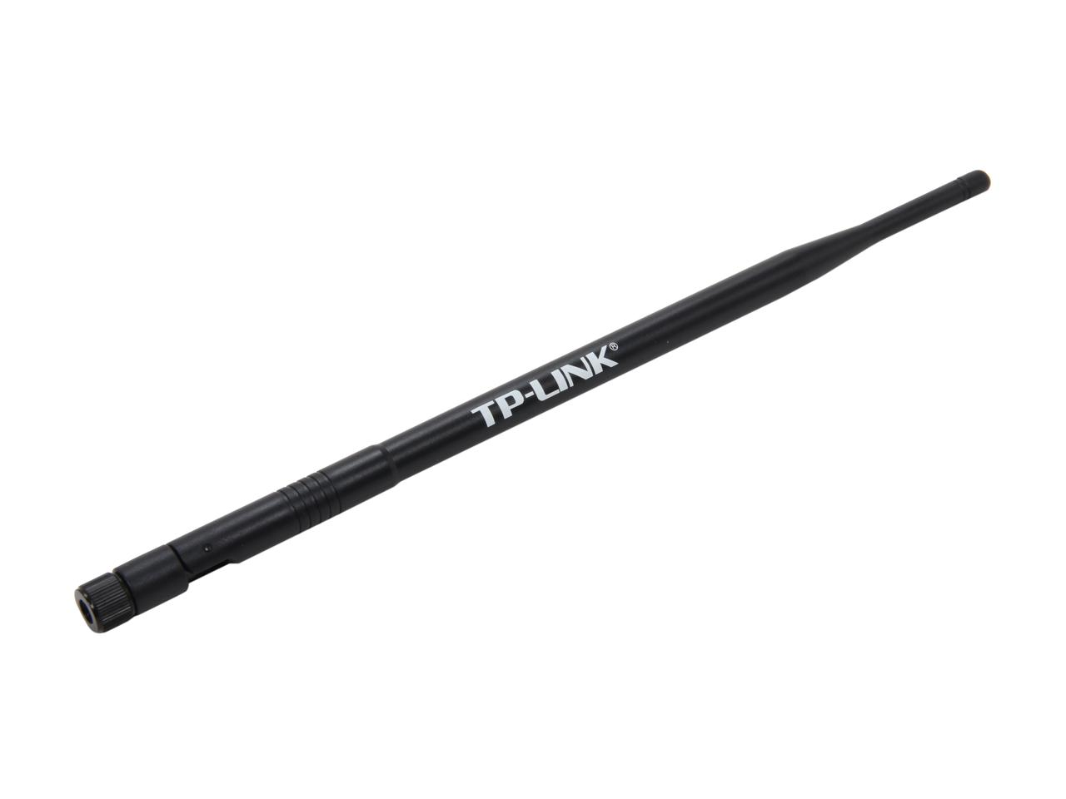
More about radio
UF.L
SMA
Propagation
Direction & Multi path
Penetration
Polarization
Antennas
Omni / directional
Connectors: SMA, UF.L, BNC, F …
Regulations
Standard bodies: FCC(US), ETSI (EU) …
Restrictions: Frequency, power, duty cycle
BNC
F
Connector | Frequency | Impedance
SMA | < 17 GHz | 50Ω
UF.L | < 6 GHz | 50Ω
BNC / F | < 3 GHz | 50Ω, 75Ω
Notes:
https://www.sparkfun.com/pages/RF_Conn_Guide
http://www.coax-connectors.com/products/connectors/f-type.aspx
European Telecommunications Standards Institute
Federal Communications Commission

Slide 9
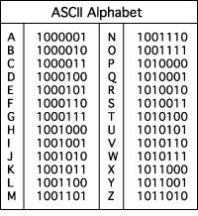
Encoding & Error control
Encoding
Text: Morse, ASCII, UTF8, CP1251 …
Images: BMP, GIF, JPEG, PNG …
Sound: Flac, Vorbis, MPEG, Speex, SILK, Opus …
Video: H264, Theora …
Error control
Detection: Parity bit, Checksum, CRC, Hash
Correction:
ACK/ARQ
FEC: Hamming, Reed-Solomon, Turbo code, LDPC

Slide 10
Internet refresher …
Notes:
https://gearjunkie.com/legacy/images/21010.jpg
https://tctechcrunch2011.files.wordpress.com/2014/11/victoria-secret-heart-rate-bra.jpg?w=738
https://cochlearimplanthelp.files.wordpress.com/2015/04/mi-band.jpg

Slide 11
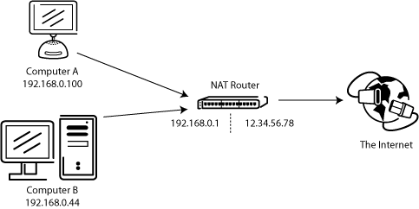
TCP/IP
IP
Private & public addresses
Routing, NAT and Firewalls
Host names (DNS)
Load balancing
DNS round robin
Virtual IP
TCP & UDP
Ports (services)
Error control & ordering
DNS

Slide 12
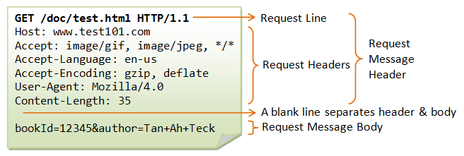
HTTP Request
Method
GET, POST, PUT, DELETE …
Headers
Accept (content type, encoding ….)
Authorization
Cache-Control
Cookies
Content-Type
Host
Body
Application specific (e.g. JSON, XML …)
Usually POST and PUT methods only
Notes:
https://www.w3.org/Protocols/rfc2616/rfc2616-sec9.html

Slide 13
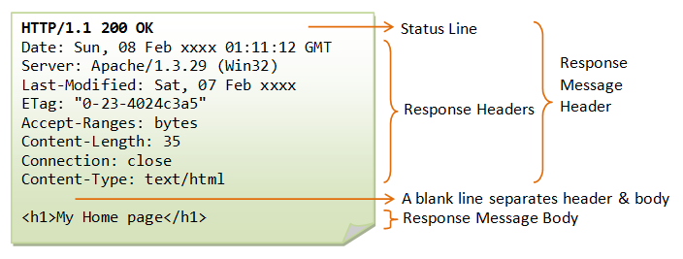
HTTP Response
Headers (subset)
Access-Control-Allow-Origin
Cache-Control
Content-Type
Set-Cookie
Status
Body
Application specific (e.g. JSON …)
Notes:
https://www.w3.org/Protocols/rfc2616/rfc2616-sec9.html
https://en.wikipedia.org/wiki/List_of_HTTP_header_fields
https://www.ntu.edu.sg/home/ehchua/programming/webprogramming/images/HTTP_ResponseMessageExample.png

Slide 14
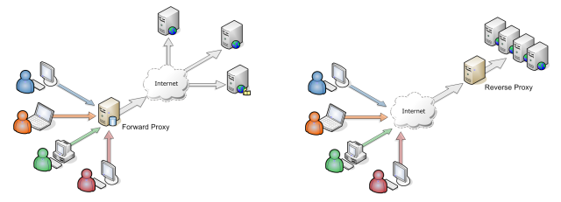
HTTP Proxies
Types of proxies
Forward proxy
Transparent proxy (with DNS)
Reverse proxy
Proxy functions
Virtual hosting
Load balancer
Cache
SSL terminator
DDoS protection
Notes:
https://www.ntu.edu.sg/home/ehchua/programming/webprogramming/HTTP_Basics.html
https://i.stack.imgur.com/0qpxZ.png

Slide 15
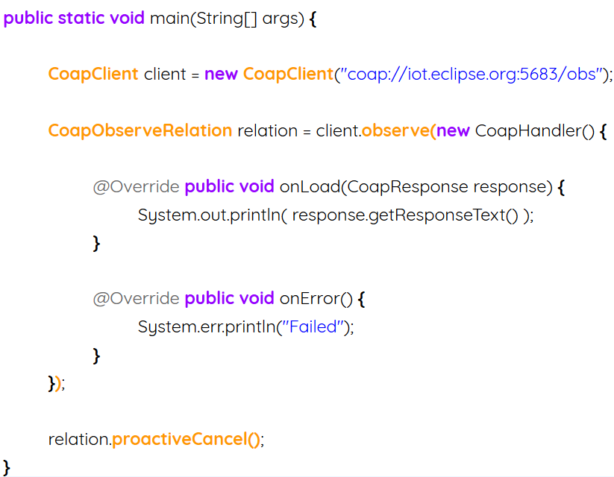
CoAP (RFC 7252)
Transparent mapping to HTTP/REST
GET, PUT, POST, DELETE
Flexible data model: JSON, XML, CBOR …
Easily made compatible with existing web
Congestion control, Crypto (TLS)
Main features
Small footprint: Works on MCUs (10KB RAM)
Observing resources (stateless and CON mode)
Group communication & Discovery
Alternative transports (UDP/DTLS, SMS, USSD)
Pre-shared secrets, certificates, or raw public keys
Notes:
http://coap.technology/
When UDP/DTLS bound (must fit a single datagram ~ 8KB - 60KB)
https://docs.google.com/presentation/d/1dDZ7VTdjBZxnqcIt6qoX742d6dHbzap-D_H8Frf3LRE/edit#slide=id.g3740c9df4_5_225
coap://coap.me:5683/

Slide 16

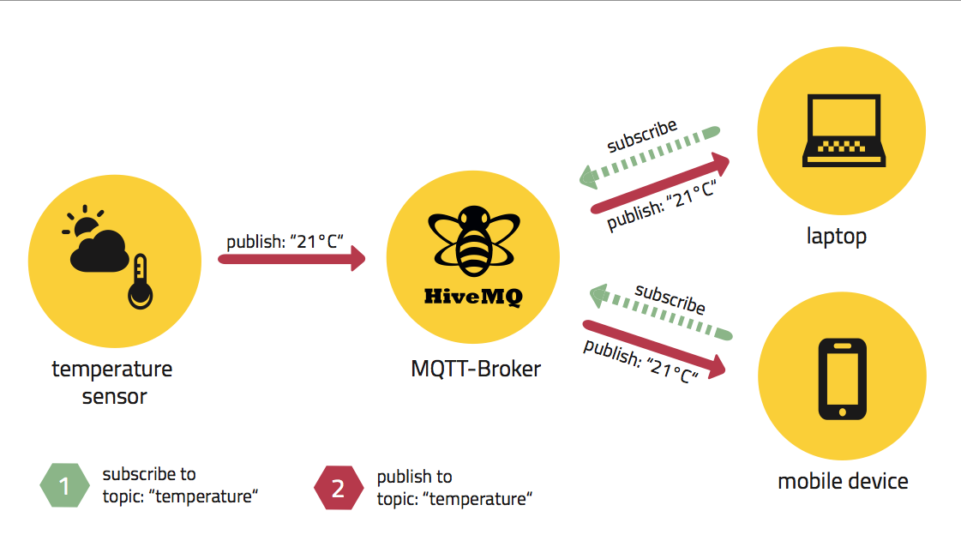
MQTT (ISO/IEC PRF 20922)
Overview
TCP/IP based
Small footprint / low bandwidth
Pub/sub (broker)
MQTT-SN: non TCP (e.g. Zigbee)
Methods
Connect / Disconnect
Subscribe / Unsubscribe
Publish
Notes:
http://www.hivemq.com/wp-content/uploads/Screen-Shot-2014-10-22-at-12.21.07.png

Slide 17
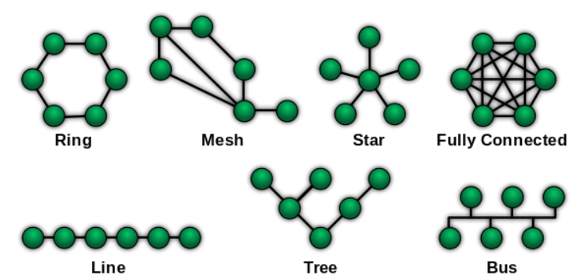
Common network topologies
P2P
Simplest
Star (Star of stars)
Common in public deployments
Mesh
Complex
Potentially more reliable

Slide 18
IoT specific protocols Wireless
Notes:
https://gearjunkie.com/legacy/images/21010.jpg
https://tctechcrunch2011.files.wordpress.com/2014/11/victoria-secret-heart-rate-bra.jpg?w=738
https://cochlearimplanthelp.files.wordpress.com/2015/04/mi-band.jpg

Slide 19

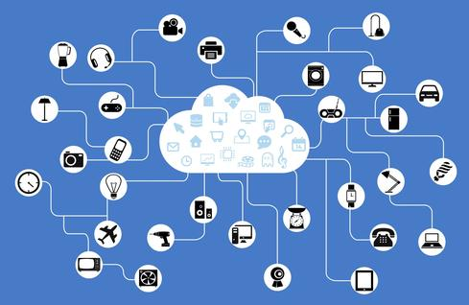
WiFi HaLow (IEEE 802.11ah)
Overview
2.4GHz, 5GHz and 868 MHz
Low power
Longer range: 1 km
Better wall penetration
26 channels x 100 Kbit/s
Thousands devices per access point
Power saving
TWT (Target wake time)
Restricted access window (contention groups)
Bi directional TXOP (faster awake)
Sectorization

Slide 20

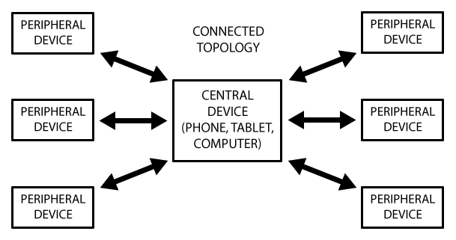
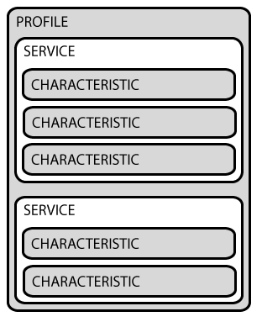
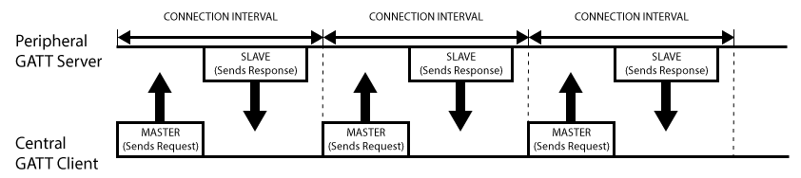
Bluetooth 4 (BLE)
GATT (generic attribute profile)
Designed for low power
Peripherals advertise themselves
Central device initiates two way connection
Profiles, Services & Characteristics
GATT Client
Heart rate service
Heart Rate Measurement
Body Sensor Location
Heart Rate Control Point
GATT Server
GATT Server
Device information service
Manufacturer name
Model name
Notes:
https://learn.adafruit.com/introduction-to-bluetooth-low-energy/gatt
https://www.bluetooth.com/specifications/adopted-specifications#GATT
https://developer.android.com/guide/topics/connectivity/bluetooth-le.html

Slide 21

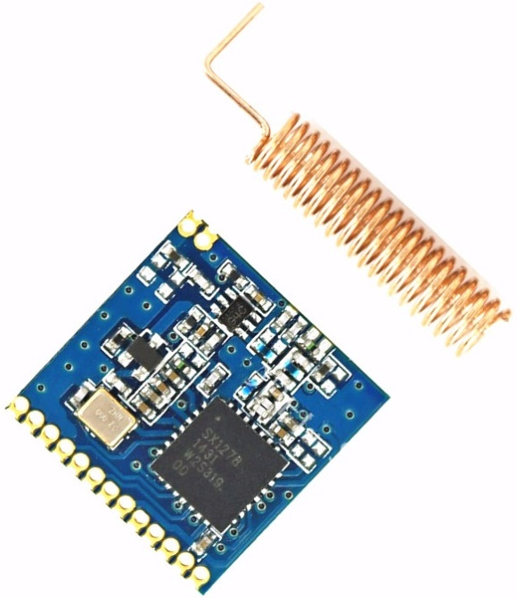
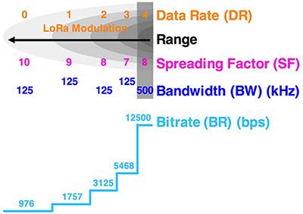
LoRa
FM Chirp Spread Spectrum & FEC
Noise like signal: SNR = -5 to -20dB
Bandwidth (7.8 – 500KHz) @ 868/915 MHz carrier
Spreading factor (64 - 4096)
Coding rate (for FEC)
Range: LoS ~20km, non LoS ~2km
Throughput = 18bps – 78Kbps
Resistance to fading (e.g. from multipath)
Interesting properties
Star, P2P and Mesh topologies
Private & Public deployments (LoRaWAN)
Military origin (anti-jamming & LPI)
C = B log₂(1+P_{S}/P_{N}) [bit/s]
Notes:
https://www.hackster.io/idreams/getting-started-with-lora-fd69d1
https://www.open-electronics.org/the-lora-shield-an-open-source-arduinos-long-range-communication-module/
https://www.link-labs.com/blog/lora-faqs
https://www.digikey.com/-/media/Images/Article%20Library/TechZone%20Articles/2016/November/LoRaWAN%20Part%201%20How%20to%20Get%2015%20km%20Wireless%2010-Year%20Battery%20Life/article-2016november-LoRaWAN-part1-fig2.jpg?ts=47efc785-e314-48c3-9659-5a654cadf7a2&la=en-US

Slide 22
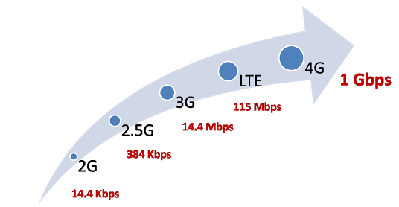


Some other protocols
Cellular
3G, LTE, 4G, Sigfox et al (UNB)
IEEE 802.15.4
Zigbee
2.4 GHz, Mesh, many vendors = Interop. problems
Use cases: Home automation, Smart buildings, meters …
Z-wave
868MHz, Mesh, single vendor
Use cases: Home automation, Smart buildings
MiWi, SNAP, Thread, 6LoWPAN …

Slide 23
IoT specific protocols Wired
Notes:
https://gearjunkie.com/legacy/images/21010.jpg
https://tctechcrunch2011.files.wordpress.com/2014/11/victoria-secret-heart-rate-bra.jpg?w=738
https://cochlearimplanthelp.files.wordpress.com/2015/04/mi-band.jpg

Slide 24
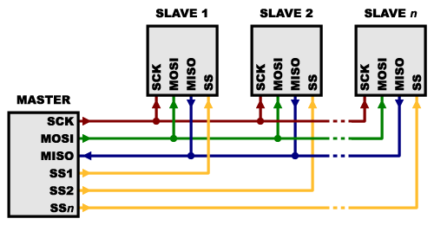
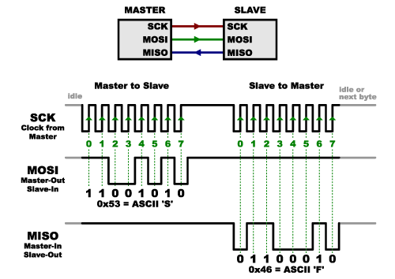
SPI (Serial peripheral interface)
Overview
Distance: 1 – 10 m
Data, Clock and Select lines
Synchronous bus (master clock)
Single master / multi slave
Full duplex, high data rate
Programming
Software vs Hardware SPI
Bit order (LSB/MSB)
Data mode (rising/falling edge)
Clock speed (divider)
Notes:
https://www.open-electronics.org/the-lora-shield-an-open-source-arduinos-long-range-communication-module/
https://www.cooking-hacks.com/sx1272-lora-module-for-arduino-raspberry-pi-intel-galileo-868-mhz
- http://www.hoperf.com/upload/rf/RFM69HW-V1.3.pdf
- http://www.analog.com/library/analogDialogue/archives/40-03/wireless_srd.html
- https://iotee.wordpress.com/
- http://www.m2comm-semi.com/our-protocol/
- http://techcrunch.com/2016/05/24/twilio-ramps-up-mobile-play-with-programmable-sims-for-iot-and-handsets-with-t-mobile/?ncid=rss
- http://www.atmel.com/images/doc8168.pdf
- http://www.atmel.com/Images/doc8227.pdf
- http://www.ti.com/lit/an/swra146b/swra146b.pdf http://www.nxp.com/products/interface-and-connectivity/wireless-connectivity/sub-1-ghz-wireless-solutions/kinetis-kw0x-48-mhz-sub-1-ghz-wireless-radio-microcontrollers-mcus-based-on-arm-cortex-m0-plus-core:KW0x
- LoRa/ISM band 863MHz connectivity + ultra low power mcu
http://mcu-bg.com/mcu_site/viewtopic.php?f=7&t=12509
http://www.rfdesignuk.com/Documents/LTE%20868MHz%20SRD%20report%20v2.pdf
http://www.amihotechnology.com/wp-content/uploads/2016/05/AM094-Product-Brief-V1-0-180516.pdf
http://www.engineering-review.bg/bg/integralni-shemi-za-bezzhichni-senzori/2/2542/
http://www.nxp.com/products/microcontrollers-and-processors/arm-processors/kinetis-cortex-m-mcus/w-series-wireless-m0-plus-m4:KINETIS_W_SERIES?cof=0&am=0
http://www.ti.com/lit/wp/swry017/swry017.pdf
http://www.hobbytronics.co.za/p/997/drf1278f-lora-module

Slide 25
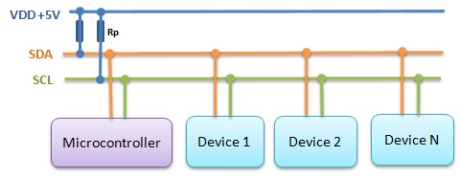
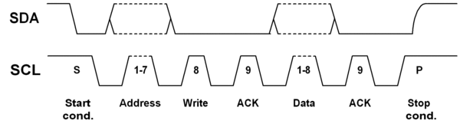
I2C
Overview
Distance: 1 – 10 m
Data and Clock lines
Synchronous bus (master clock)
Multi-master / up to 1008 slaves
Half-duplex, 100 kbit – 3.2mbit/s
Programming
Slave address: 7/10 bit
Open address
Write data
Read data
Notes:
https://www.i2c-bus.org/addressing/

Slide 26
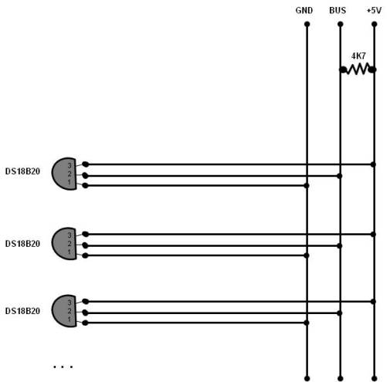
OneWire et al
Overview
Distance: 10 to 100s of meters
Radius & weight
Half-duplex, 16 kbit / 125 kbit (overdrive)
Data line only (2/3 wire interface)
Single master / up to 100s of slaves
Programming
64bit slave IDs
Parasitic power (charge up)
Find devices
Communicate
Notes:
http://neutrino.phys.ksu.edu/~gahs/doublechooz/DC_SlowMRS/AN148.pdf
http://platformio.org/lib/show/1/OneWire

Slide 27
Some other protocols
Async Serial
UART (3.3 / 5 V, few meters)
RS232 (9600 bps/ 15m)
RS485 (100kbps / 1200m)
CAN
Industrial
CIP (common industrial protocol)
Ethernet (PROFINET)
Modbus (PLCs), Profibus, 4-20 mA
I2S
HiFi sound
Notes:
https://www.automation.com/automation-news/article/profibus-and-modbus-a-comparison

Slide 28
Exercise
Notes:
https://gearjunkie.com/legacy/images/21010.jpg
https://tctechcrunch2011.files.wordpress.com/2014/11/victoria-secret-heart-rate-bra.jpg?w=738
https://cochlearimplanthelp.files.wordpress.com/2015/04/mi-band.jpg

Slide 29
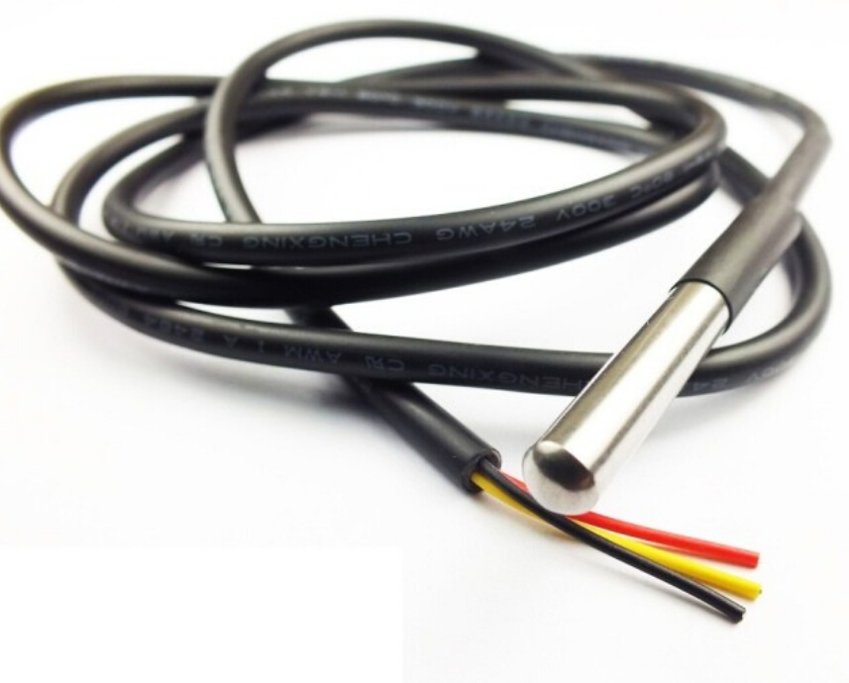
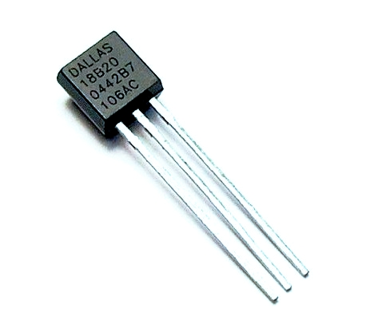
Exercises
OneWire DS18B20 temperature sensor
Connect one sensor
Connect two sensors
Bluetooth 4.0 HR sensor
Review source code
Identify where heart rate is being received
Notes:
https://github.com/oerjanti/BLE-Heart-rate-variability-demo

Slide 30
Thank you
Contact information:
Pavel Genevski
Research Expert
SAP Labs Bulgaria

Slide 33
The Grid
Headline area
White space
Drawing area

